Slide 1
FRENCH TO ENGLISH TRANSLATOR
Presented By:
Abhi Roobini S (715522243001)
Dhanusree N (715522243014)
Jwanisha K (715522243022)
Kavitha S (715522243024)
Yamini R (715522243060)

Slide 2
Problem Statement:
The primary goal of our project is to develop a Speech-to-Speech Translation System that enables seamless communication between speakers of different languages. This system aims to bridge language barriers by allowing users to speak in one language (French language) and receive spoken output in another language (English language), without the need for manual transcription or translation.

Slide 3
Proposed Solution
French speech Input: Users enter French speech for translation.
Accurate Translation: The system provides grammatically correct English output.
Simple UI: Clean and user-friendly interface for easy interaction.

Slide 4
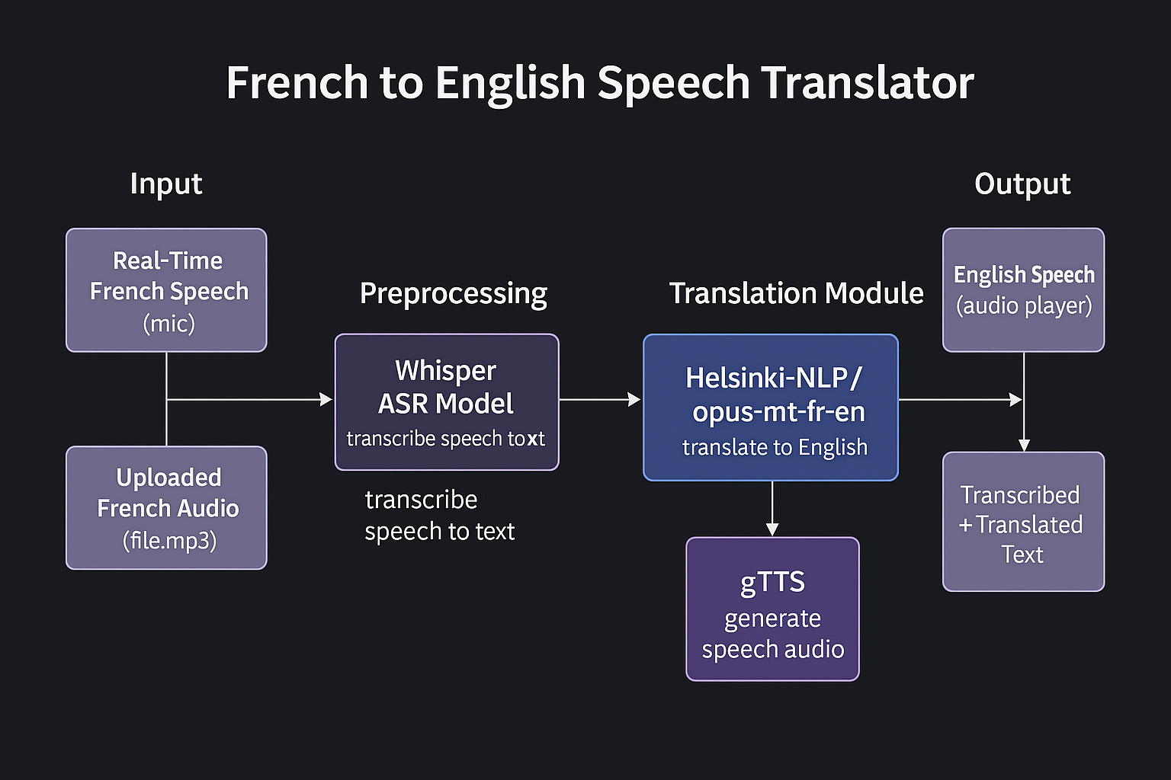
System Architecture:

Slide 5
Technologies Used:
Python – Core programming language for logic.
Hugging Face Transformers – For French-to-English translation.
Streamlit – Frontend interface for user interaction.
Google Colab – For model development and testing.
GitHub – For version control and project collaboration.

Slide 6
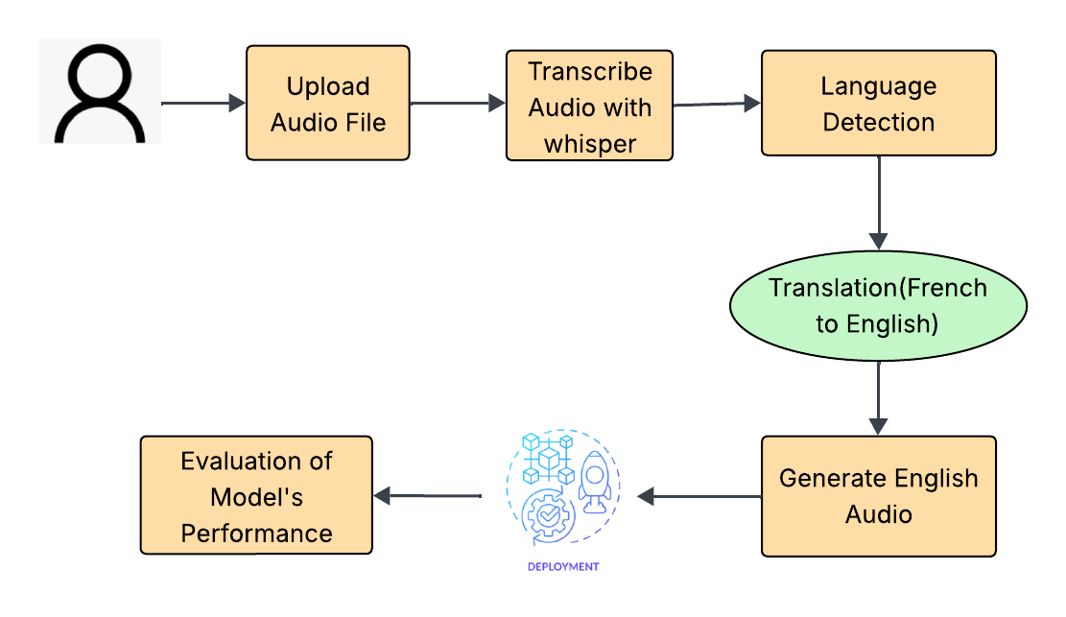
Workflow:

Slide 7
Models Used and Their Purpose
Whisper (base) – by OpenAI Used for transcribing speech to text (ASR) Converts spoken French audio into written text.
Helsinki-NLP/opus-mt-fr-en – by Hugging Face Used for translating French text to English text Neural Machine Translation (NMT) model specifically trained for the fr-en language pair.
gTTS (Google Text-to-Speech) Used for converting English text to English speech Generates human-like audio output of translated text.

Slide 8
Evaluation Metrics:
1. WER (Word Error Rate)
Evaluates: Transcription (French audio → text)
Goal: Lower WER = Better accuracy
Formula:
WER=S+D+I​
N
2. BLEU Score
Evaluates: Translation (French text → English)
Goal: Higher BLEU = Better translation
Measures: n-gram overlap with reference

Slide 9
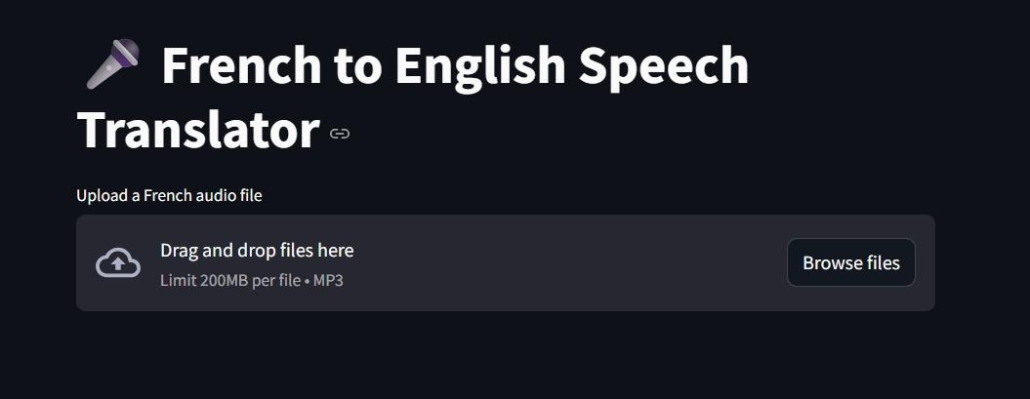
Output:

Slide 10
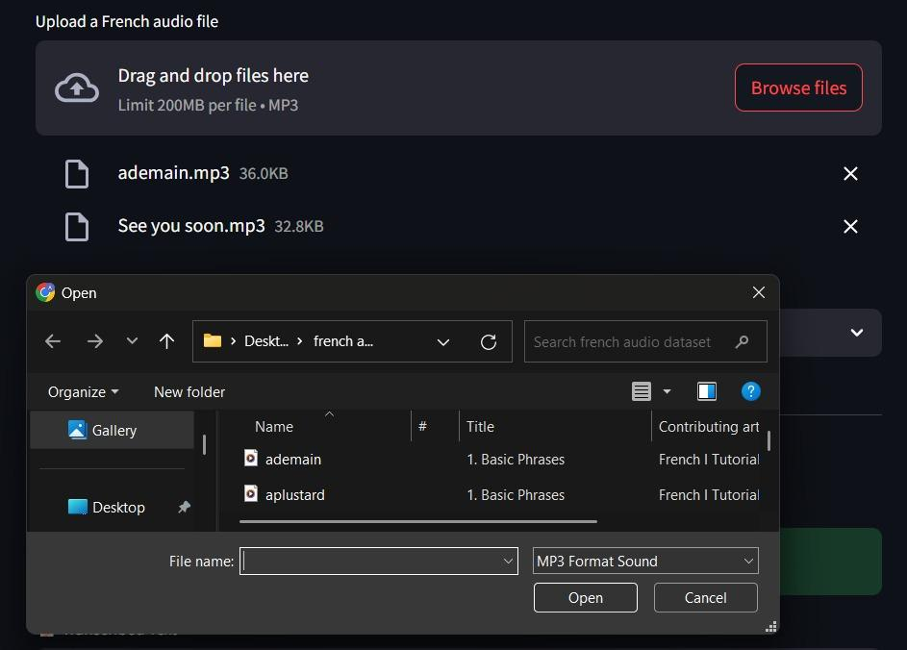
o

Slide 11
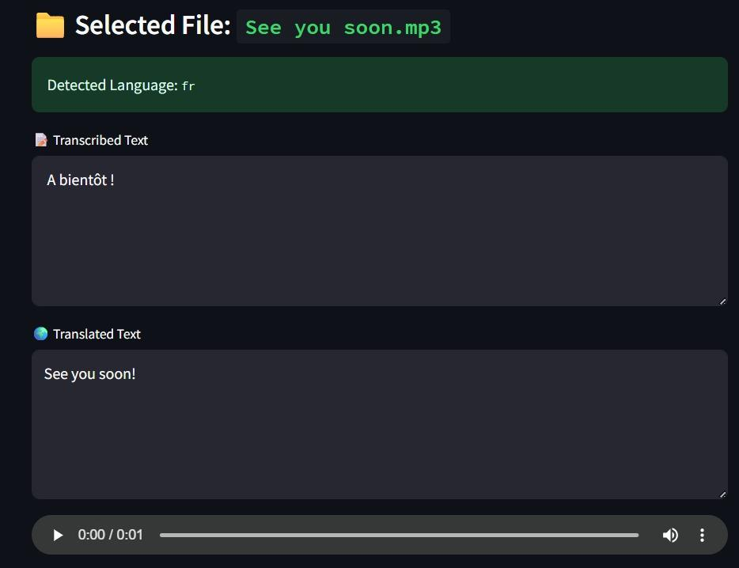
o

Slide 12


Slide 13
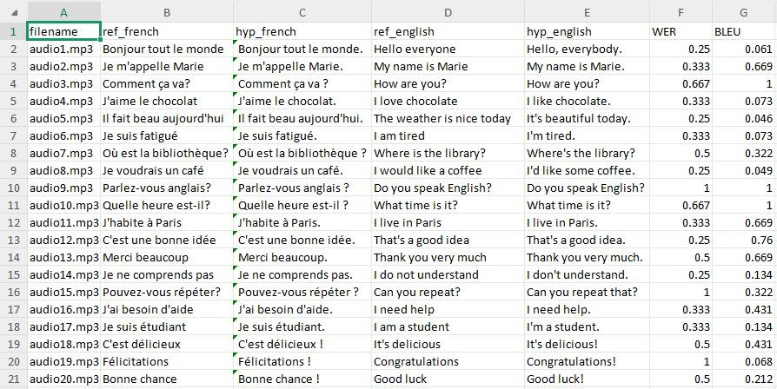
Evaluation:

Slide 14
This evaluation table summarizes the performance of your French-to-English speech-to-speech translation system using two key metrics:
1.High Accuracy Overall:
Many entries have low WER (≤ 0.35), indicating accurate French speech transcription.Several entries have high BLEU scores (close to 1), indicating good translation fidelity.
2.Strong Performance Examples:
audio02.mp3: WER = 0.333, BLEU = 0.669 — good transcription and translation.
audio11.mp3: WER = 0.333, BLEU = 0.909 — very good.
audio13.mp3: WER = 0.35, BLEU = 0.696 — excellent translation despite minor transcription errors.

Slide 15
3.Areas for Improvement:
audio03.mp3: WER = 0.667 — high transcription error.
audio14.mp3: WER = 1, BLEU = 0.134 — very poor transcription and translation.
audio20.mp3: WER = 0.5 — moderate transcription error with modest BLEU.
4.Stable Translations Despite Errors:
Some files like audio10.mp3 have high WER but still achieve high BLEU (WER = 0.667, BLEU = 1), meaning the translation may still be semantically accurate.

Slide 16
Conclusion:
Your system performs well for most simple and common phrases, but struggles with:
1.Speech clarity or accents (higher WER)
2.Less common phrases (low BLEU)
Improving transcription accuracy (e.g., using a larger Whisper model or cleaner audio) can improve overall translation quality.

Slide 17
THANK YOU

